Slide 1

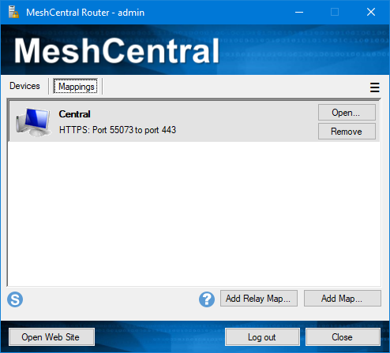

MeshCentral
Browser
Agent
Web Server

Slide 2
MeshCentral
Browser
Agent
Web Server

Slide 3
MeshCentral
Redirection Port 80
Main Port 443
Relay Port 453
Used to relay web page
{
"settings": {
"port": 443,
"redirport": 80,
"RelayPort": 453
}
}

Slide 4
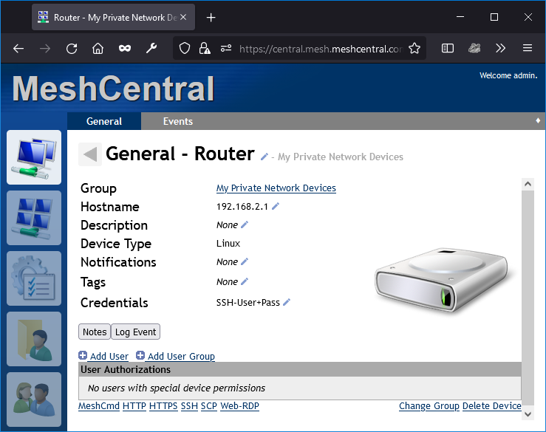
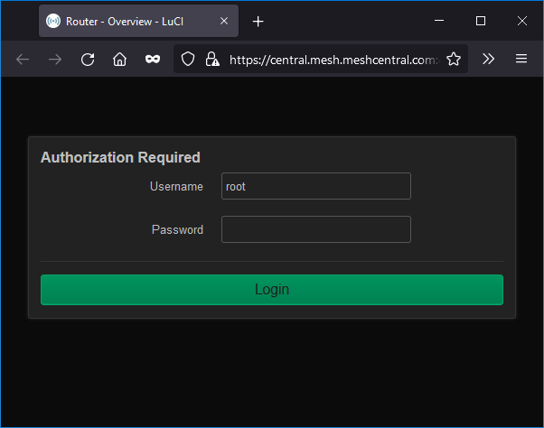
{
"settings": {
"port": 443,
"RelayPort": 453
}
}

Slide 5
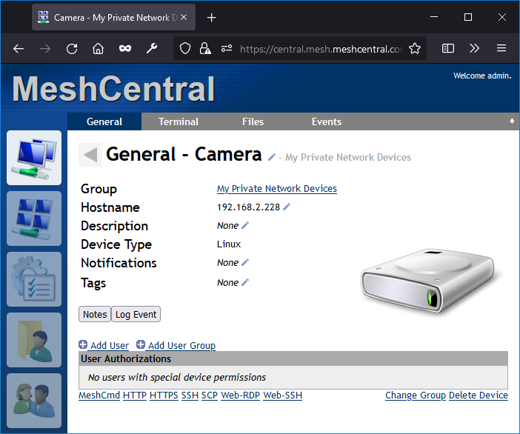
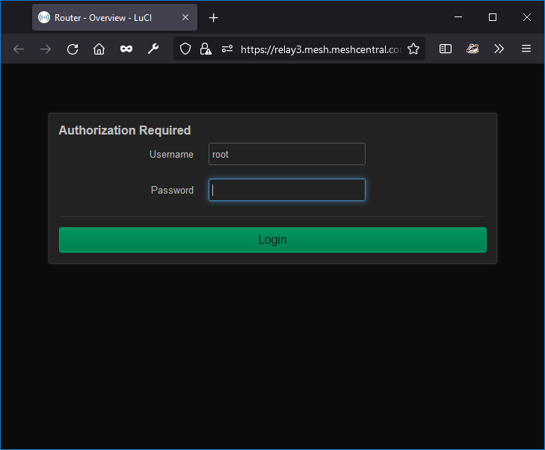
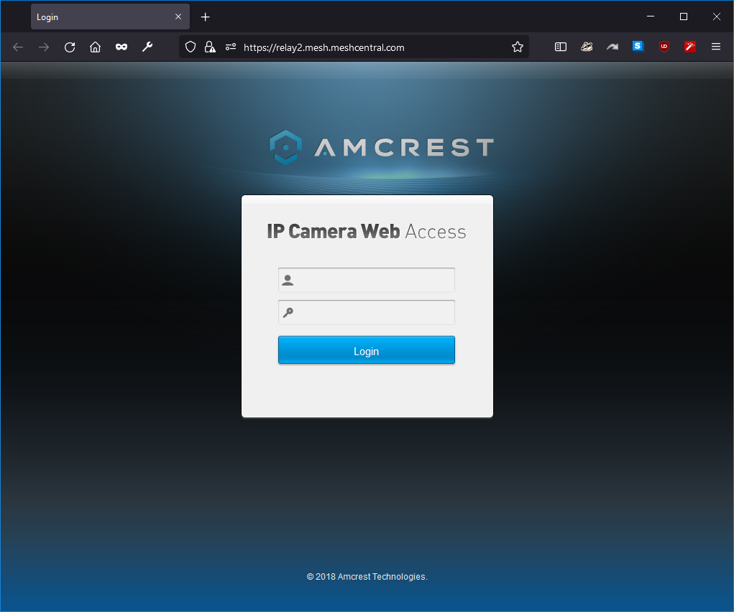
myserver.com
relay1.myserver.com
relay2.myserver.com
relay3.myserver.com
{
"settings": {
"port": 443,
"RelayDNS": [
"relay1.myserver.com“,
"relay2.myserver.com“,
"relay3.myserver.com“
]
}
}

Slide 6

NodeID
Address
Port
TLS or not
MeshCentral
Relay Port 453
HTTPS
Web Server

Slide 7
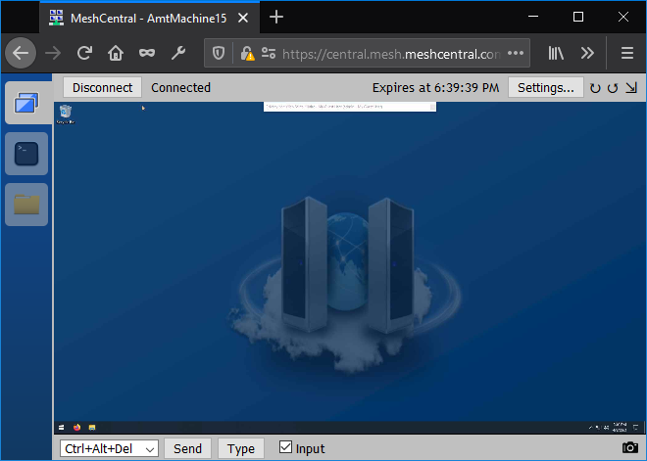
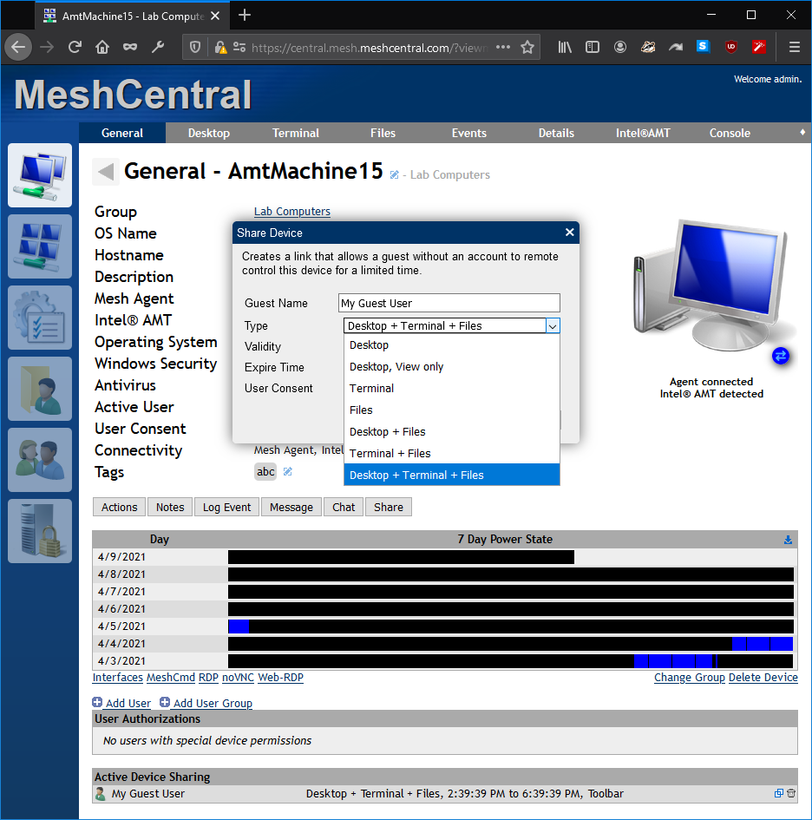
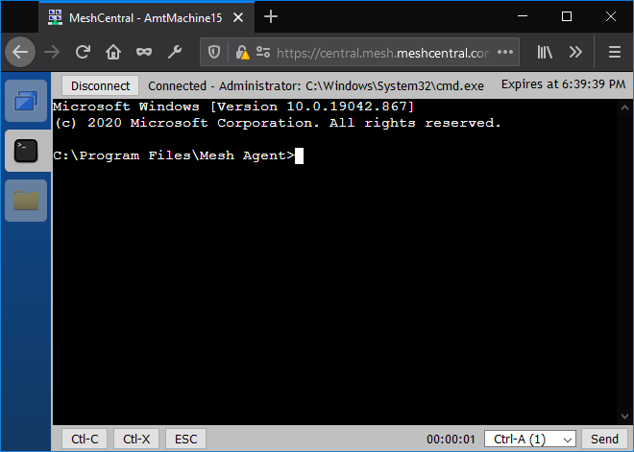
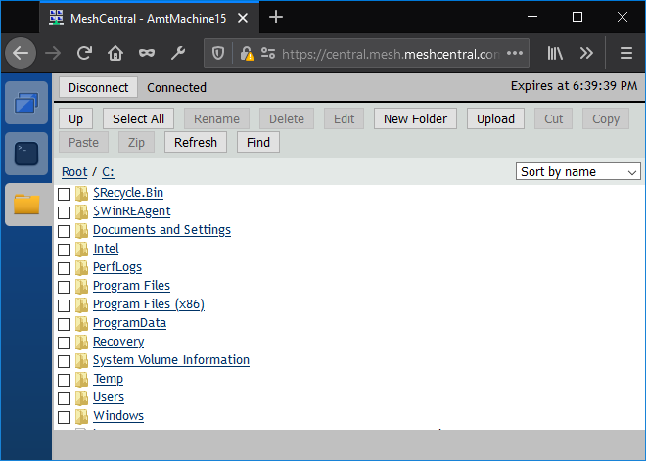

Slide 8
